Slide 1
The Voice
16-bit MIPS Structure General Processor
Presentation 8

Slide 2
The Voice
Specification
Data path width | 16 bit
Frequency | 200 MHz
Pipeline stage | 5
Voltage | 1.1 V
Standard cell area | 8502 um²
Allocation area | 12996 um²
Density | 61.4%
Total internal power | 4.463 mW
Total switching power | 1.753 mW
Total leakage power | 0.05 mW
Total power | 6.267 mW

Slide 3
The Voice
Contents:
Instruction set
Single cycle design
Pipeline design
Assembler
Synthesize and Layout
Demo

Slide 4
Instruction set:
The Voice
 |  | Opcode(15-11) | Rs(10-8) | Rt(7-5) | Rd(4-2) | Shamt(1-0)
R | ADD | 00100 |  |  |  | 00
 | SUB | 00000 |  |  |  | 00
 | AND | 00101 |  |  |  | 00
 | OR | 00110 |  |  |  | 00
 | XOR | 00001 |  |  |  | 00
 | SLL | 00010 |  |  |  | Amt(1-0)
 | SRL | 00011 |  |  |  | Amt(1-0)
 | MUL | 00111 |  |  |  | 00
I | ADDi | 01100 |  |  | Immediate(4-0)
 | ANDi | 01101 |  |  | Immediate(4-0)
 | ORi | 01110 |  |  | Immediate(4-0)
 | LW | 10100 |  |  | Immediate(4-0)
 | SW | 11100 |  |  | Immediate(4-0)
 | BEG | 11000 |  |  | Immediate(4-0)
J | J | 100XX | Address (10-0)
HLT | halt | 010XX

Slide 5
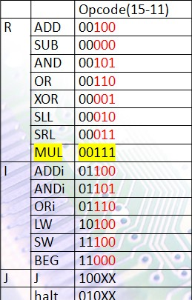
Instruction set:
The Voice
Send to the Control unit
 | R 00x | iA 011 | Lw 101 | Sw 111 | BEG 110 | J 100 | Halt 010
RegDst | 1 | 0 | 0 | 0 | 0 | 0 | 0
Branch | 0 | 0 | 0 | 0 | 1 | 0 | 0
Jump | 0 | 0 | 0 | 0 | 0 | 1 | 0
MemRead | 0 | 0 | 1 | 0 | 0 | 0 | 0
MemtoReg | 1 | 1 | 0 | 1 | 1 | X | 0
MemWrite | 0 | 0 | 0 | 1 | 0 | 0 | 0
RegWrite | 1 | 1 | 1 | 0 | 0 | 0 | 0
ALUSrc | 0 | 1 | 1 | 1 | 0 | x | 0
Regread | 1 | 1 | 1 | 1 | 1 | 0 | 0

Slide 6
Instruction set:
The Voice
Send to the ALU
Operation | Instruction[13-11] | Specific operation
Add | 100 | Add,Addi,LW,SW
SUB | 000 | Sub,BEQ
AND | 101 | AND,ANDi
OR | 110 | OR,Ori
XOR | 001
SLL | 010
SRL | 011
MUL | 111

Slide 7
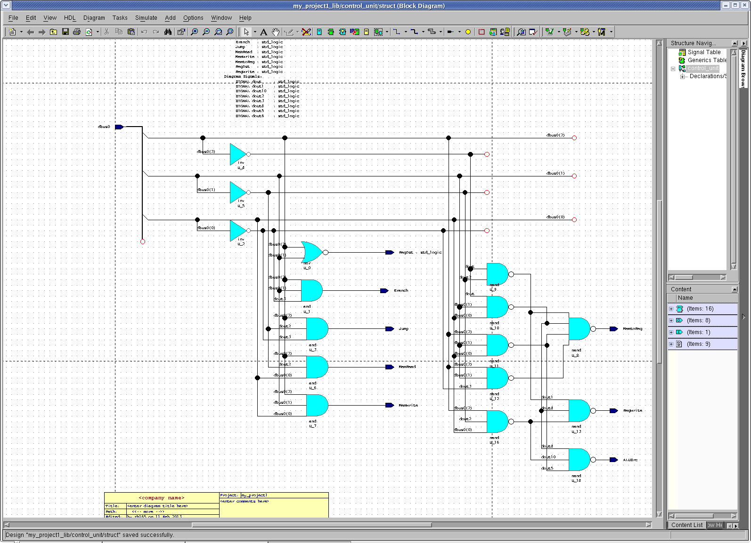
The Voice
Control unit structure:

Slide 8
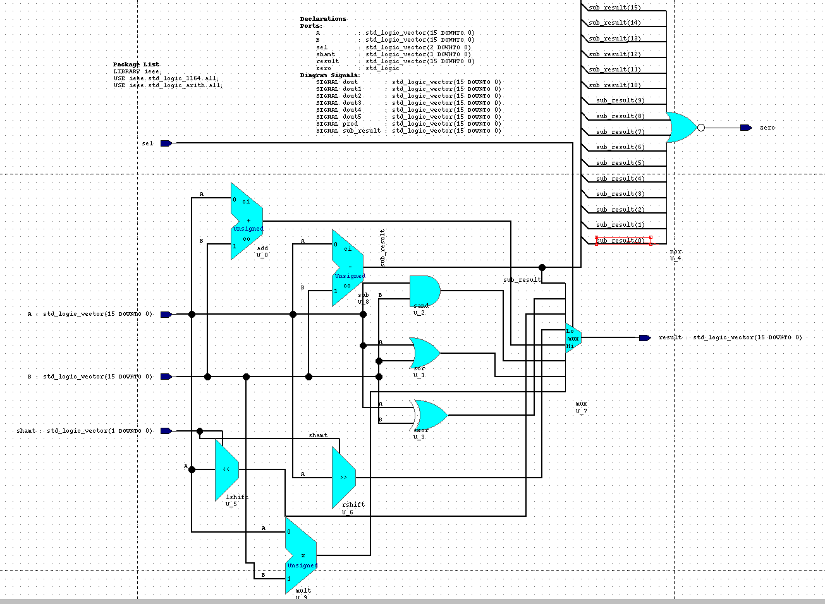
The Voice
ALU Structure:

Slide 9
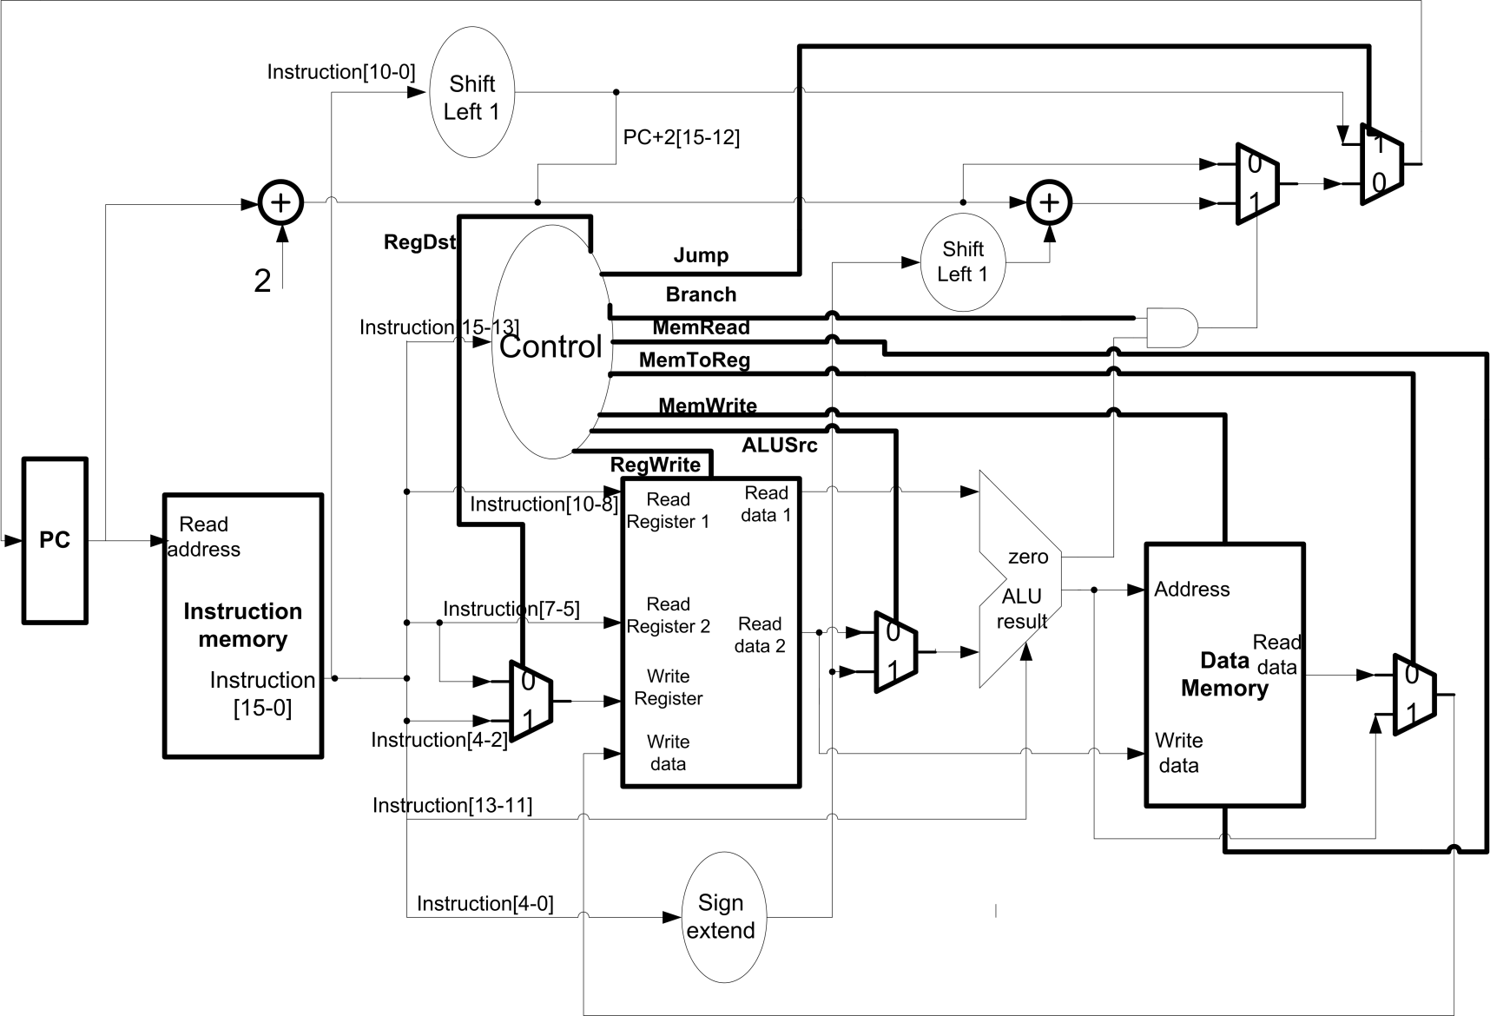
The Voice
Single Cycle Design:

Slide 10
The Voice
Single Cycle Design:
Pull of, add to the test bench

Slide 11
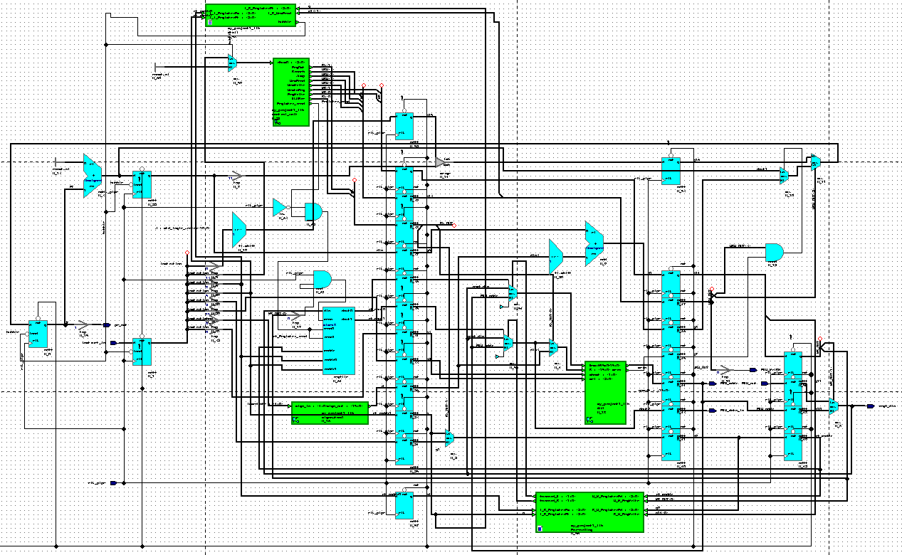
The Voice
Pipeline Design:

Slide 12
The Voice
Pipeline Design:
Solution:
1. bubble:
Addi R0, R1, 7
Halt
Halt
Add R1, R2, R0
2. forwarding
*Assembly file
Addi R0, R1, 7
Add R1, R2, R0
Data dependency!

Slide 13
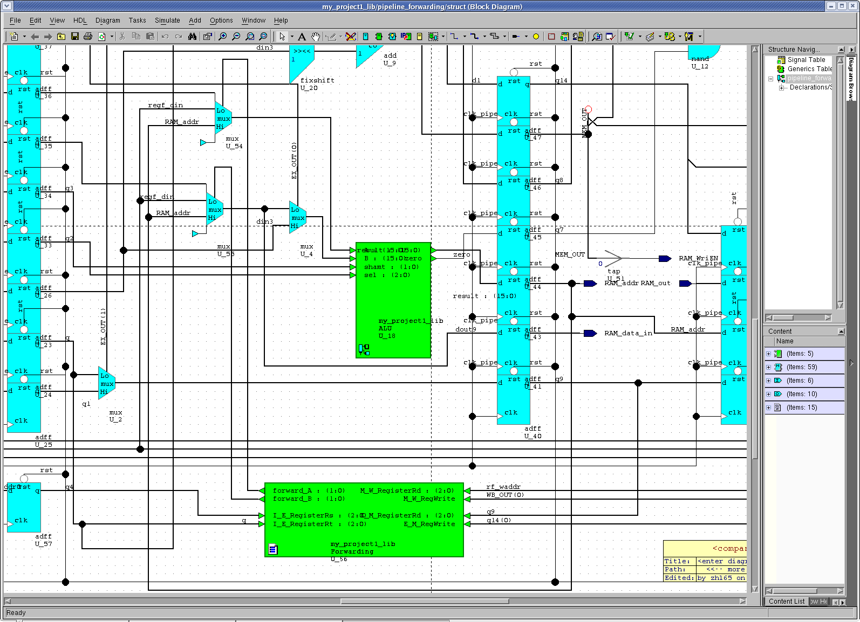
The Voice
Forwarding

Slide 14
The Voice
Forwarding
forward_A <= "10" WHEN ((E_M_RegWrite='1') and (E_M_RegisterRd =I_E_RegisterRs))ELSE
"01" WHEN ((E_M_RegisterRd /= I_E_RegisterRs) and ((M_W_RegWrite='1') and (M_W_RegisterRd = I_E_RegisterRs)))ELSE
"00";
forward_B <= "10" WHEN ((E_M_RegWrite='1') and (E_M_RegisterRd =I_E_RegisterRt))ELSE "01" WHEN ((E_M_RegisterRd /= I_E_RegisterRt) and(( M_W_RegWrite='1') and (M_W_RegisterRd = I_E_RegisterRt)))ELSE
"00";
ALU input A | 00 | Register file Dout0
 | 01 | Write back data
 | 10 | Piped ALU result
ALU input B | 00 | Register file Dout1
 | 01 | Write back data
 | 10 | Piped ALU result

Slide 15
The Voice
Pipeline Design
*Assembly file
LW R0, R1, 7
Add R1, R2, R0
Solution: add bubble
1.Software
  Convenient
  disturbing branch and jump!
2. Hardware
Data dependency!

Slide 16
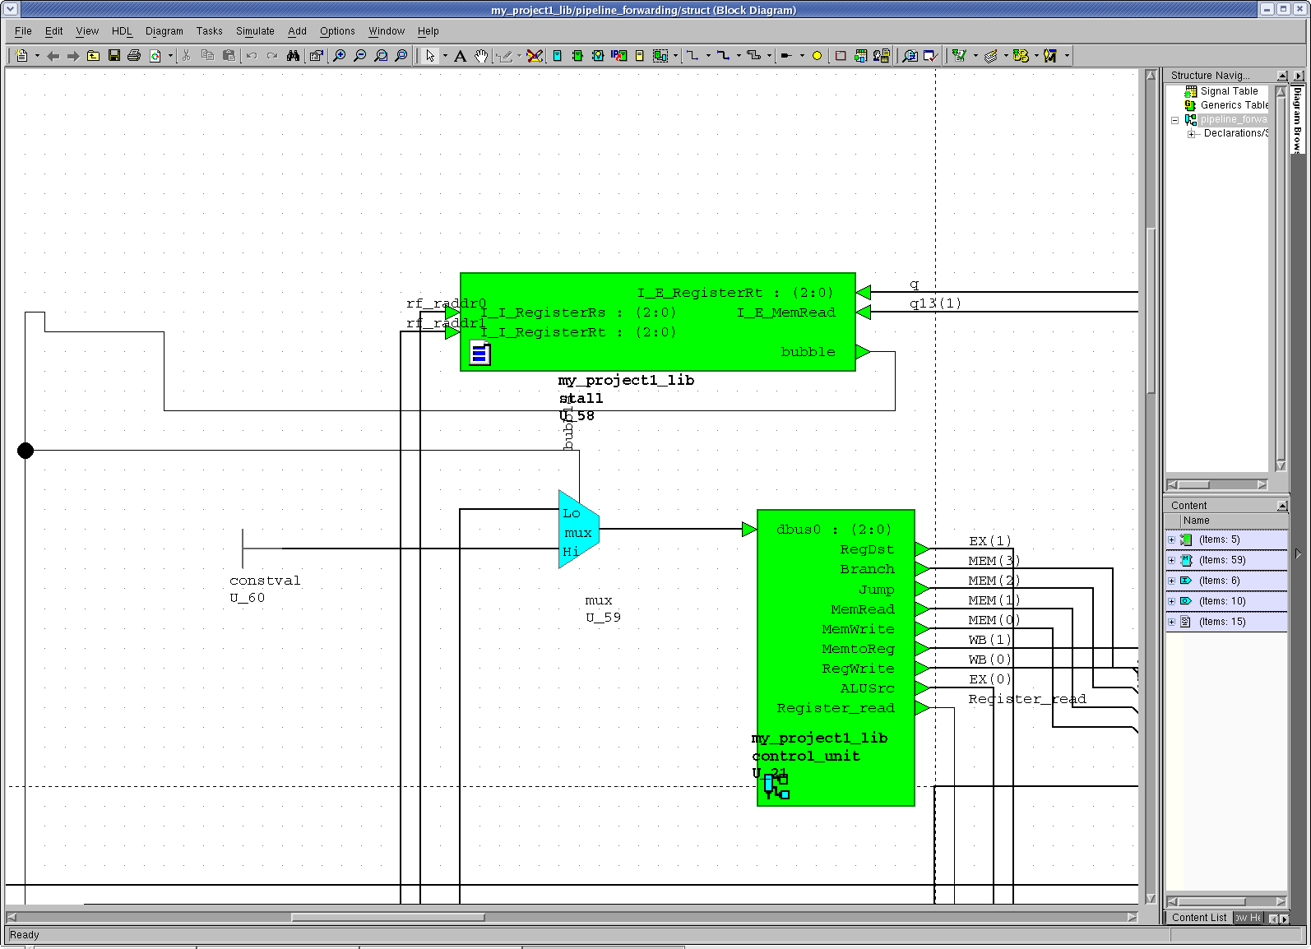
The Voice
Stall
Halt: 010
Stop PC and the first stage
bubble<= '1'when ((I_E_MemRead ='1') and ((I_E_RegisterRt = I_I_RegisterRs) or (I_E_RegisterRt = I_I_RegisterRt)))else
'0';

Slide 17
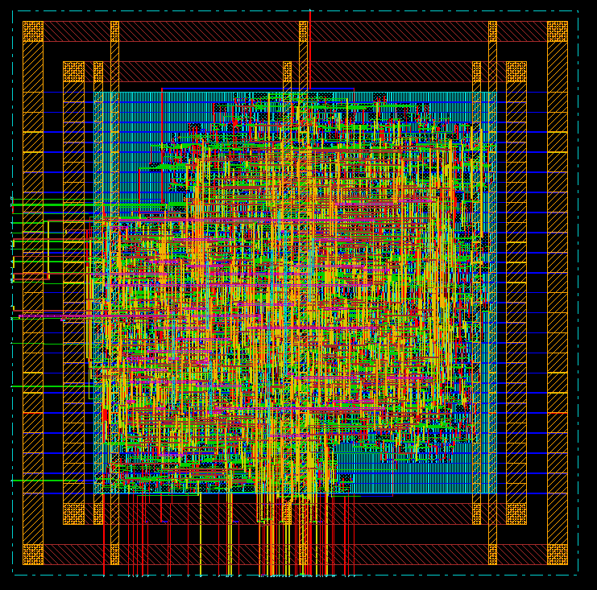
The Voice
Layout:
Single cycle layout:

Slide 18
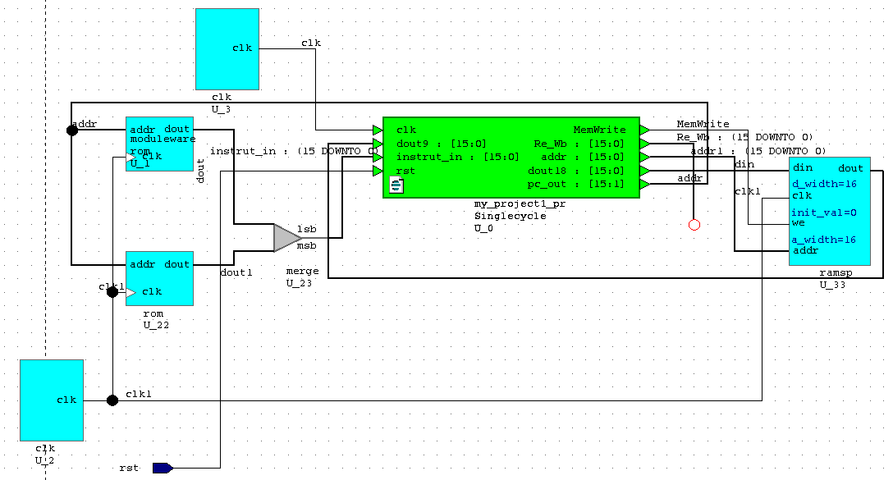
The Voice
Problem: How to simulate the design in different levels?
Solution: Using test bench

Slide 19
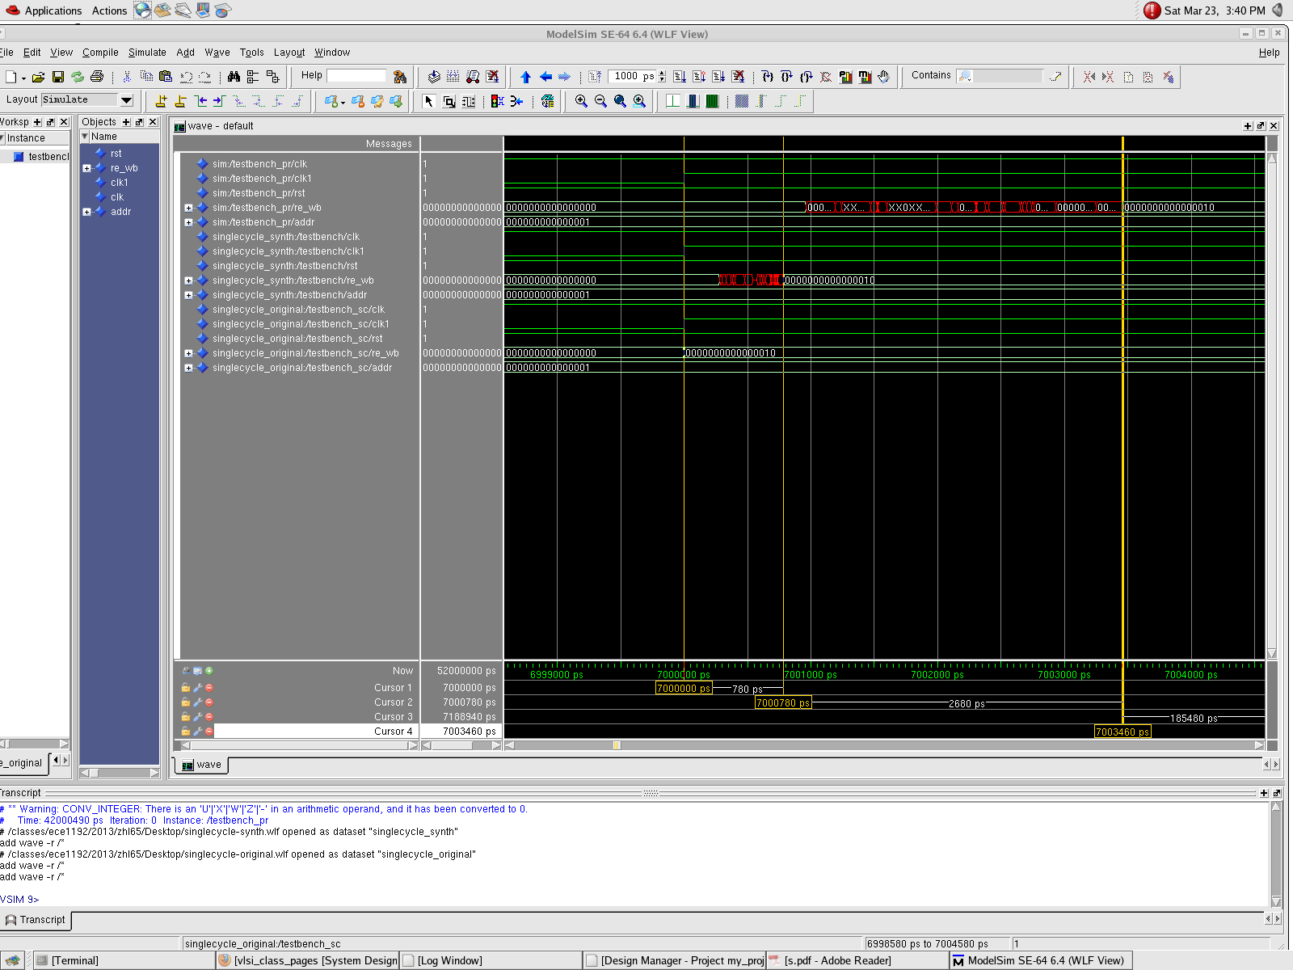
The Voice
Single cycle simulation result:
Layout
Synthesize
BEH

Slide 20
The Voice
Single cycle simulation result:
 |  | delay
Functional | 7000000 ps | -
Synthesis | 7000780 ps | 780 ps
layout | 7003460 ps | 3460 ps

Slide 21
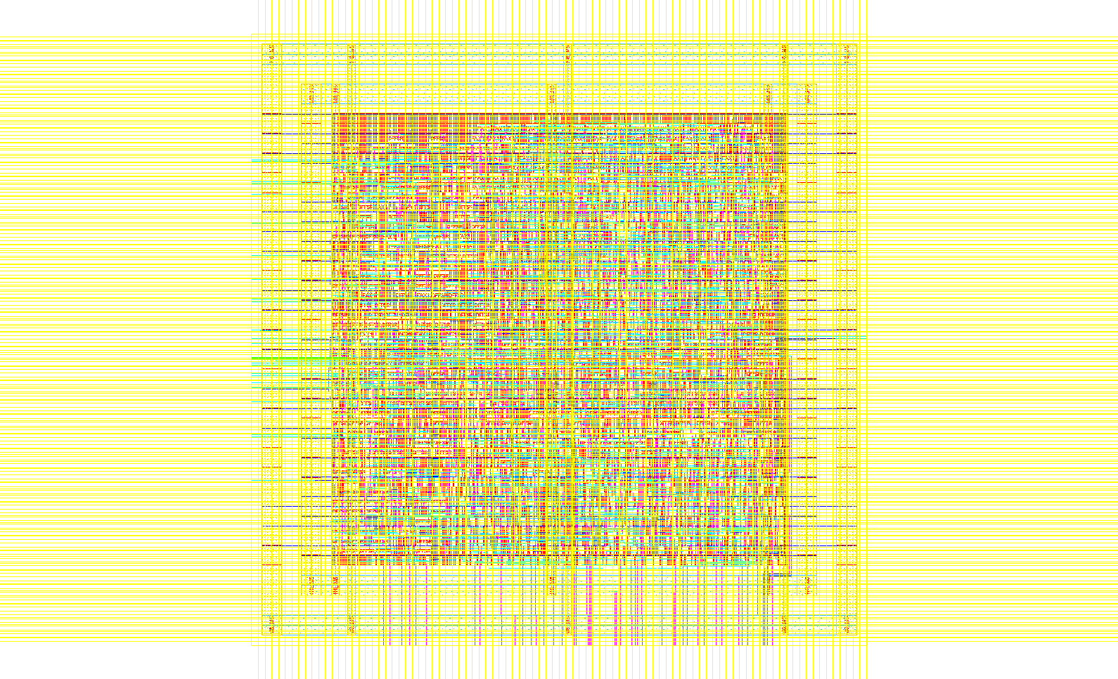
The Voice
Pipeline layout

Slide 22
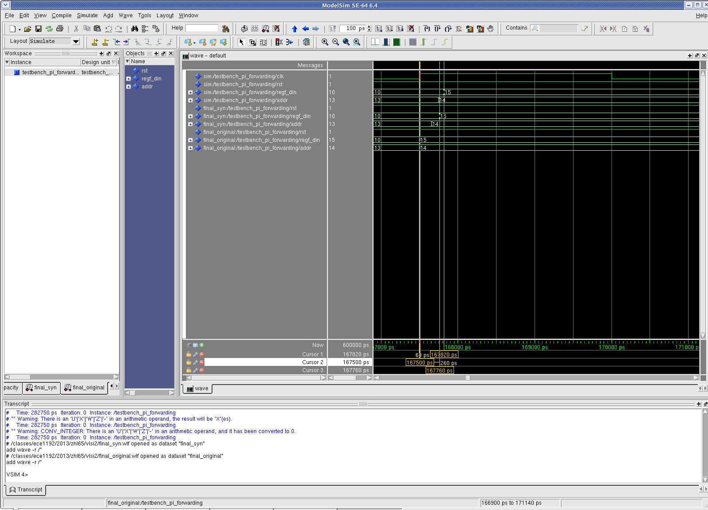
The Voice
Pipeline simulation result

Slide 23
The Voice
Pipeline simulation result
 |  | delay
Functional | 167500 ps | -
Synthesis | 167760 ps | 260 ps
layout | 167820 ps | 3200 ps

Slide 24
The Voice
Problems and solutions….
When do synthesize…
Problem: Wrong result
Reason: The Moduleware’s register file is triggered by electric level, instead of edge.
Write and read simultaneously lead to errors.
When do place and route…
Problem: Red waveform
Reason: Write enable and Read enable signal overlap
Solution:
Write enable
Write enable’
CLK
Read enable
Read enable’
CLK

Slide 25
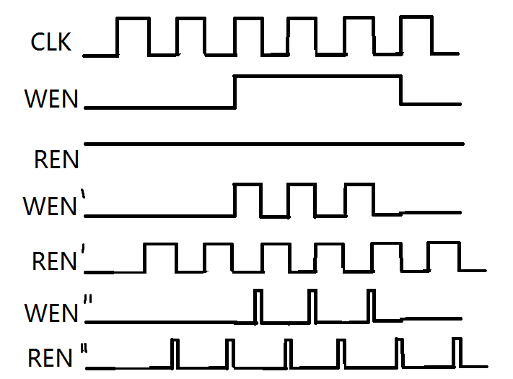
The Voice
Problems and solutions….

Slide 26
The Voice
Assembler
Add bubble? Yes!
......
mul r1,r0,r1
sw r1,r0,0
lw r2,r0,0
beq r1,r2,7
ble
ble
ble
addi r3,r0,7
add r2,r2,r3
sub r2 r2 r1
mul r2 r2 r2
mul r2 r2 r2
j 8
ble
ble
Ble
......
......
mul r1,r0,r1
sw r1,r0,0
lw r2,r0,0
beq r1,r2,4
addi r3,r0,7
add r2,r2,r3
sub r2 r2 r1
mul r2 r2 r2
mul r2 r2 r2 j 8
......

Slide 27
Key (opcode) | Value (bubble #)
Jump | 3
Beq | 3
… | …
Implementation
Foreach line in sourcefile
{
readline=> $opcode, $destC, $sourceA, $sourceB;
Output_array[line]=($opcode, $destC, $sourceA, $sourceB;)
PC++;
If(opcode in op_add_bubble[]) add_ble pc++;
If(opcode in op_has_offset[]) store line to chang_offset[];
Tansfer[line] = new_pc
}
Foreach line in change_offset {
adjust_offset();
}
Foreach pc in output_array{
output $opcode, $destC, $sourceA, $sourceB;
}

Slide 28
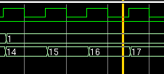
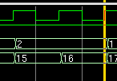
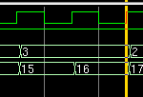
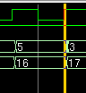

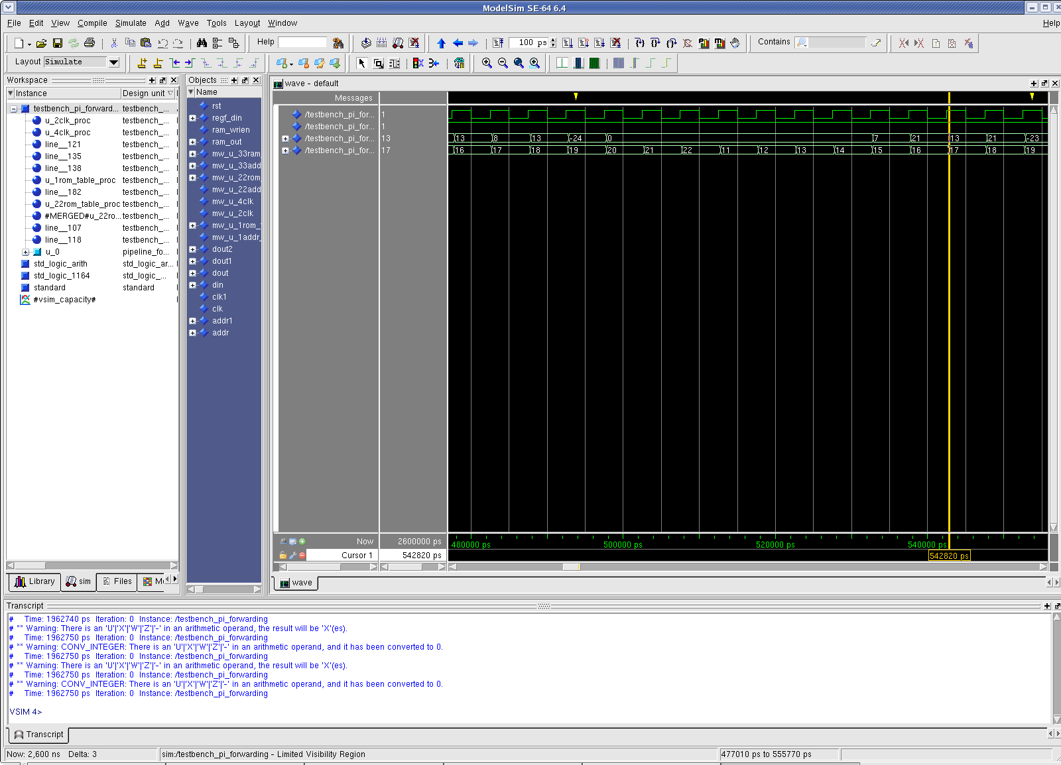
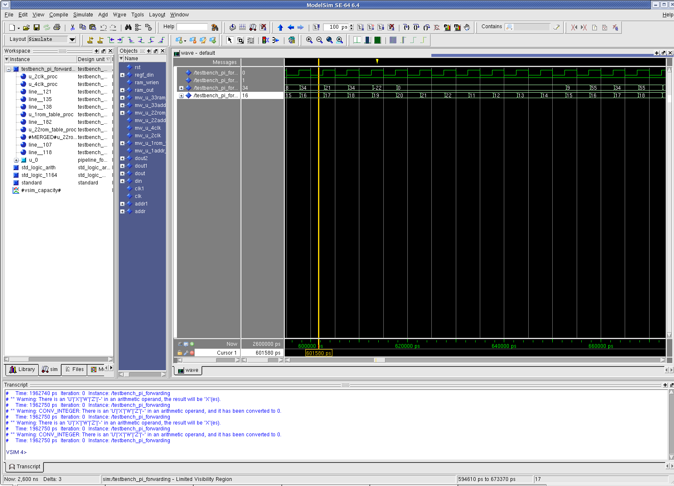









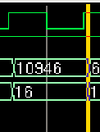
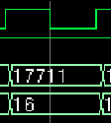


The Voice
Fibonacci number

Slide 29
The Voice
Demo

